Slide 1
3E0X1 Grounding

Slide 2
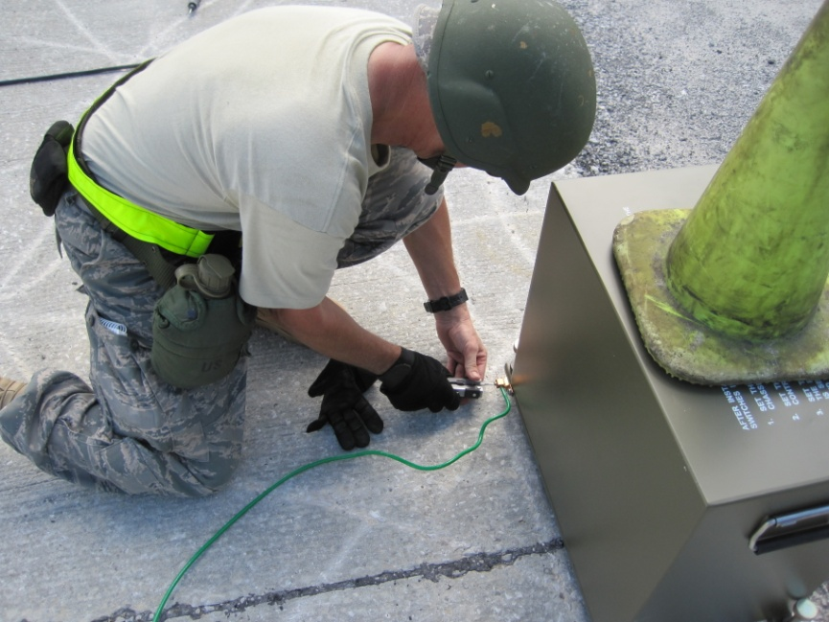
Objective
OBJECTIVE
Discuss aspects of grounding systems
Notes:
Going to use this equipment
What else? Ohm meter

Slide 3
Overview
Types of meters
Static grounds
Equipment grounds
System grounds
Lighting ground
Obtaining better grounds
Testing and maintenance
Notes:
Vibro ground
Digital ohm meters

Slide 4
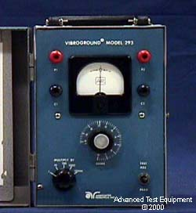
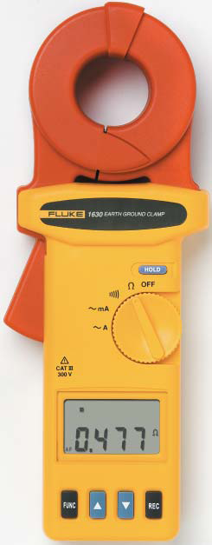
Meters and Test Equipment
What do we use to test ground resistance of grounding systems?
Vibroground
Clamp-on ground resistance tester
Notes:
Think about charging it before you need it…

Slide 5
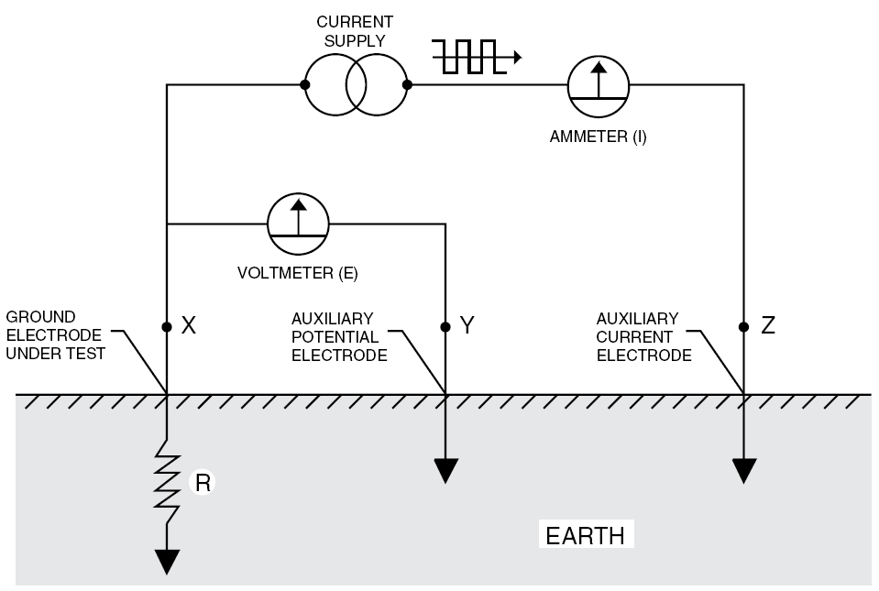
Meters and Test Equipment
Fall of Potential 3-Point Measurement
Three-point measurement is used to measure resistance to ground of ground rods and grids. The potential difference between rods X and Y is measured by a voltmeter, and the current flow between rods X and Z is measured by an ammeter.
By Ohm’s Law E = RI or R= E/I, we may obtain the ground electrode resistance R.
It is not necessary to carry out all the measurements when using a ground tester. The ground tester will measure directly by generating its own current and displaying the resistance of the ground electrode.
Notes:
If you are unable to balance the galvanometer on any range, improper connections may be responsible, or the grounding system resistance may be beyond the range of the instrument. Another possibility is your batteries may be low, or dead. Always carry an extra battery.
Vibroground safety
There is a possibility of high voltages being present while you test grounds, so wear your rubber gloves to avoid an electrical shock.
If bands overlap you will get messed up readings
Manufacturers instructions are very important…
Keep refering to y and z but the pic says 1 and 2
USES OHMS LAW E=IxR to get the resistance
Pass around our vibroground pamphlet
Question about if you do not know the depth of the rod? What do you do
Pulled up the PDF…
? Question about the reading variation if the rods are too far apart ?
The L method need to explain

Slide 6
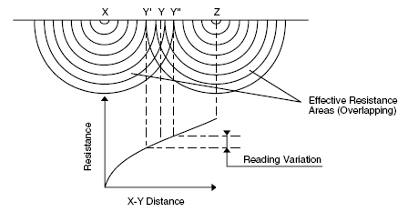
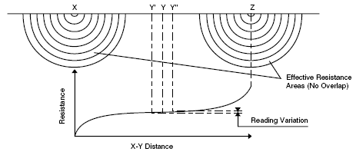
Meters and Test Equipment
Fall of Potential 3-Point Measurement
Notes:
If you are unable to balance the galvanometer on any range, improper connections may be responsible, or the grounding system resistance may be beyond the range of the instrument. Another possibility is your batteries may be low, or dead. Always carry an extra battery.
Vibroground safety
There is a possibility of high voltages being present while you test grounds, so wear your rubber gloves to avoid an electrical shock.
If bands overlap you will get messed up readings
Manufacturers instructions are very important…
Keep refering to y and z but the pic says 1 and 2
USES OHMS LAW E=IxR to get the resistance
Pass around our vibroground pamphlet
Question about if you do not know the depth of the rod? What do you do
Pulled up the PDF…
? Question about the reading variation if the rods are too far apart ?
The L method need to explain

Slide 7
Grounding Principles
There are basically four types of grounding systems
Static Grounds
Equipment Grounds
Electrical System Grounds
Lightning Grounds
These grounds are installed in the same basic manner; however, their purposes are quite different.
Notes:
Give example of walking dragging feet is static
Water drop 10000v

Slide 8

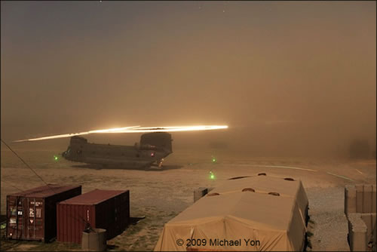
Grounding Principles
Static grounds
A static ground is defined as a connection made between a piece of equipment and earth for the purpose of draining off static electricity charges before a sparking potential is reached. Typically, static grounding involves connecting large metal objects, such as certain fuel tanks and aircraft, to earth through a ground rod. Resistances as high as 10,000 megohms often provide an adequate leakage path for static electricity. For the grounding of aircraft, Air Force Instruction (AFI) 32-1065, Grounding Systems, specifies a 10,000 ohm maximum for all static grounds. It is important to remember that static grounds are not part of an electrical power system.
Notes:
BONDING Before securing any bond, it is necessary to ensure electrical continuity by removing any paint, oil,
dirt, or rust so you have electrically clean contact surface. At least two separated flexible bonding
straps are provided when bonding a frequently moving body such as a metal door, hinged shelf, or
table. Bonds are not made to gas, steam, oil, air, or hydraulic lines, or to sprinkler system piping or
metallic bodies connected to lightning protection system, except as required below finished grade. Air
Force Instruction 32-1065, Grounding Systems, and NFPA 780, Standards for the Installation of
Lightning Protection Systems both cover bonding requirements in more detail.
? Question air refueling static ? Aircraft parking apron
Static grounds in aircraft parking areas use copper-clad ground rods. Ground rods are at least 5/8- or 3/4-inch in diameter and 8 feet long. Add more lengths as necessary to get the right ohmic value. Leave recess cavities at each ground rod location to set the top of the rod below the apron surface. Make the recessed cavity wide enough to attach static grounding clamps to the ground rod.
In hydrant refueling areas, install one static ground between each hydrant outlet and its electrical junction box. Connect the junction box and the hydrant outlet to the ground rod with 1/0 copper cable.
Hangar floors
Grounding devices in hangar floors fill the requirements for aircraft static and equipment grounding. A static grounding system with an ohmic value of 10,000 ohms is adequate for dissipating any aircraft static electricity to ground, however equipment grounding is restricted to 25 ohms when the equipment's static ground is isolated from the hangar's electrical system ground. Therefore, we use 25 ohms as the maximum for this dual-purpose system. Interconnect floor-grounding systems below the concrete floor, and connect them to the hangar electrical service grounding system.
In hangars, use ground rods that are at least 3/a-inch diameter by 2 feet long, copper-clad welded t5rpes, interconnected with No. 4 AWG bare copper wire or larger. Use an exothermic weld to bond
this bare copper wire to the ground rod. Testing in POL areas
In addition to visually inspecting grounding systems, we also make resistance measurements. Test static ground rods only when installed or when physically damaged. Resistance of a static ground may be up to 10,000 ohms, but the lowest possible resistance gives maximum electrostatic charge bleed off in minimum time.
NOTE: Remember, the system's dual purpose inside hangars makes the maximum resistance 25 ohms.
Measuring static bus bars
Test static bus bars by connecting one lead of a digital ohmmeter to a ground rod of the facility grounding system. Connect the other lead (in turn) to all the free ends of the bus bar. Bolted connections between bus bar sections are not considered free ends. Investigate any reading more than 3 ohms and correct it. Perform a visual inspection to make sure materials and connections are in good condition.
Static electricity hazards
A drop of liquid falling through space can build up charges of 10,000 volts in a split second under proper conditions; it starts to spark or arc at about 350 volts. Static charges of only 1,500 volts can ignite gasoline fumes.

Slide 9
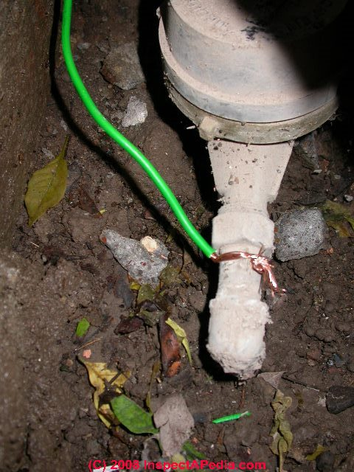
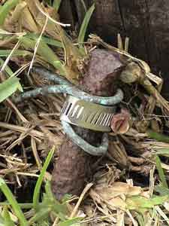
Grounding Principles
Equipment grounds
Equipment grounding pertains to the interconnecting and connection to earth of all noncurrent-carrying metal parts of an electrical wiring system, including equipment connected to the system. Connect the equipment ground to an electrical system ground (neutral) only at the service entrance of a building. The resistance at this point should not exceed 25 ohms to ground.

Slide 10
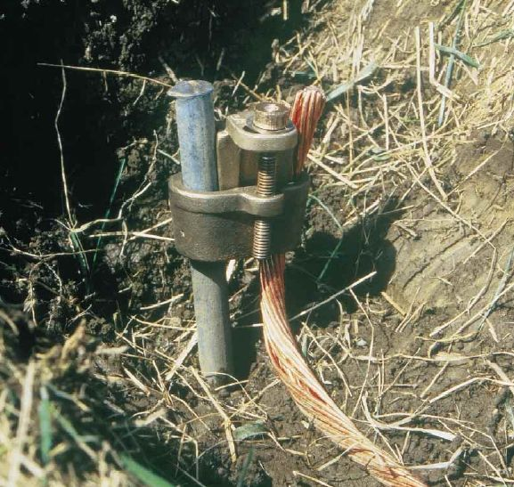
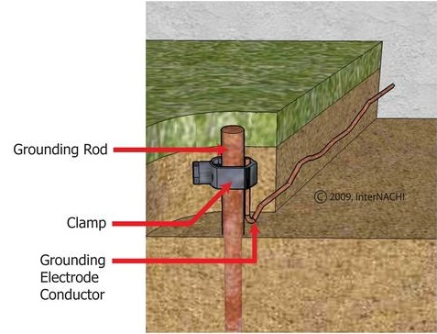
Grounding Principles
Electrical System Grounds
The purpose of electrical system grounds is to stabilize voltage to ground and give a low-impedance path for fault currents. An electrical system ground refers to the condition of having one wire or point of an electrical circuit connected to earth. The most likely place to make the connection is at the electrical neutral (the system ground). Examples are generator or transformer neutral points connected to earth and the grounded neutral of an interior wiring system. Ground cables should be copper. Only use other metals or metal combinations in those cases where the mechanical strength of copper is inadequate
Notes:
While connection to an extensive metallic water system usually provides a ground resistance of less than 3 ohms, there is always the possibility that water main maintenance or other work might result in accidental disconnection of grounds and create a hazardous condition. Therefore, such connections should only be provided as a secondary backup to constructed electrodes
Pic on the left is for lightning
Galvanized in corosive area

Slide 11
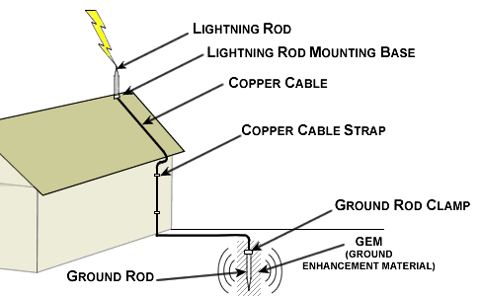
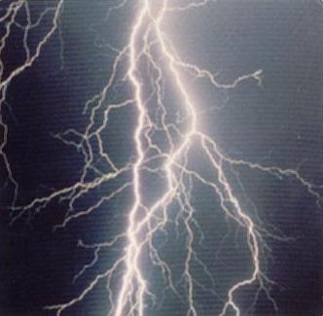
Grounding Principles
Lightning grounds
The purpose of a lightning ground is to safely dissipate lightning strokes into the earth. It is one of several parts that make a complete lightning protection system. A complete lightning protection system usually consists of air terminals (lightning rods), down conductors, arresters, and other connectors or fittings. The lightning protection system protects the building, its occupants, and its contents from the thermal, mechanical, and electrical effects of lightning.
Notes:
Air terminal
Down conductor
Why only 1? Distance of the terminal

Slide 12
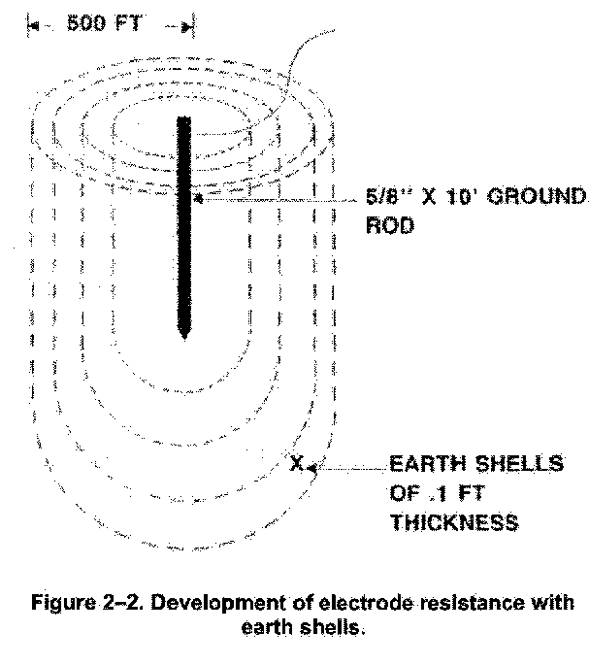
Grounding Principles
Resistance of electrodes
In figure 2-2,you see how electrode resistance
develops with earth shells. The electrical resistance (measured in ohms) between a grounding electrode and remote earth represents the effectiveness of the electrode. This resistance is the sum of the
resistances (in series) of all the successive shells of earth. This starts at the electrode and extends outward to about 50 times the maximum dimension of the electrode. The shell nearest the rod has the smallest circumferential area or cross section, so it has the highest resistance. Successive shells outside this one have progressively larger areas and thus progressively lower resistance.
Notes:
For example, if L is 0.1 feet or 3.05 cm, assume P to be 10,000 ohm,/cm, and A is the average surface area of a cylinder with one hemispherical end. The radius of the first shell is 5/16 inch + 0.05 feet (0.794+4.525 cm).The radius of the second shell is 5/16 inch+0.15 feet(0.794+4.575cm).If you
calculate the resistances of all the shells to 500 feet, you see that 25 percent of the total resistance to remote earth is within 1 1/5 inches (first shell) of the rod. Also,68 percent of the total resistance is found within one foot and 94 percent is within 25 feet of the rod.
Maybe use step potential to help explain these bands. If you dead squirrels at the base of the poles why?

Slide 13
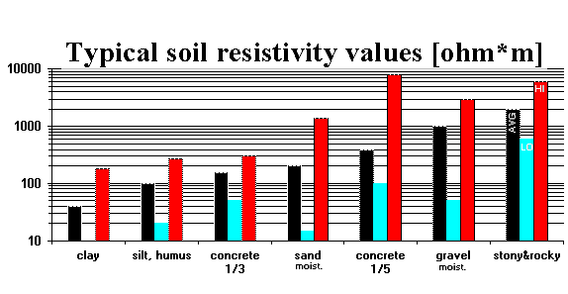
Grounding Principles
Notes:
History records on large area ground grids show little variation in the measured value of resistance for
many years. However, the soil resistivity measurements in the same area showed wide variations of as
much as 17 to I at shallow depths. While this appears to contradict the previous paragraph, it is
nevertheless true. Remember that the resistance of a grounding connection with a few driven rods can
vary more closely with that indicated by soil resistivity (seasonal) changes. This indicates that the
resistance of large area grids is proportional to resistivity measurements made for greater depths
having less variation. Simply stated, the deeper the ground rod, the less effect seasonal changes in
soil resistivity have on electrode resistance. Earth consists of rock derivatives such as sand and clay, solubles such as salts and acids, and about 20 percent water. Rock derivatives are highly resistive and do not contribute to the carrying of current. In the absence of the water and salts, the earth is a good insulator. The salts and water become an electrolyte, which has a moderate resistivity. Since electrolyte content determines soil conductance, its resistivity varies with temperature in the manner in which electrolytes vary. Electrolytes have a negative temperature-resistivity characteristic. As temperature goes up, resistivity goes down. This is the opposite of metal resistivity, which goes up with temperature. The effects of water and temperature combine to make grounds less effective in winter than summer. Resistance readings are generally lower in spring since water content tends to offset the cooler temperatures. You can
eliminate the confusion seasonal changes cause by checking the grounds at the same time each year.
Horrizontal grounds in rocky soil
Surface area is KEY
What is 1/3 and 1/5 concrete
Seasonal changes change these values ie temp moisture
? What is humus ?

Slide 14
Grounding Principles
Obtaining better grounds
Ways to Lower Resistance | Explanation
Effects of deeper rod penetration | As a rod penetrates deeper into the soil, it makes more surface contact with the earth. Also, the deeper the soil, the more conductive it is. As pointed out above, the deeper the electrode, the less the effect of the surface moisture content and temperature. This is the preferred method.
Parallel ground rods | Space the rods driven parallel to each at least the length of the rods apart. Multiple rods connected by a conductor have a greater ability to equalize potential over the installation area.
Soil replacement | You can significantly lower the resistance of a ground rod by lowering the resistance of the soil immediately surrounding it. The cathodic protection specialists have a good method of doing this. This mixture is better than chemical salts because it lasts much longer. Do the following: 1. Dig a hole 8 to 12 inches in diameter. 2. Center the ground rod in the hole. 3. Mix together 75 percent gypsum, 20 percent bentonite (well driller's mud), and 5 percent sodium sulfate. Prepare enough to fill the hole almost to the top. 4. Place the dry mixture in the hole surrounding the rod to within 6 inches of the top and tamp the mixture down. 5. Finish filling the rest of the hole with earth and tamp it down.
Concrete encapsulation | Encapsulating ground rods with concrete increases their effective diameter. The concrete also absorbs water from the soil for good conductivity directly around the electrode. When buried in the earth, the resistivity of concrete is about 3,000 ohm/cm.
Other made electrodes | Sometimes, butt grounds or ground plates are provided on poles as an economical method of grounding the overhead ground wire, but as their use is permitted only in areas with low soil resistance, use such grounding methods only where such an installation is locally practiced. These made electrodes cannot be used as the sole grounding electrode for apparatus or neutral grounds, which require a ground rod installation as a minimum.
Notes:
High soil resistivity makes it difficult to obtain satisfactory low electrode resistance. The table below explains several ways to lower the resistance of the electrode (in order of preference).
#2 If you use multiple do you have to widen the distance or is it the length of one only? ?

Slide 15
Grounding Principles
NFPA 70, National Electrical Code.
NFPA 77, Static Electricity.
NFPA 780, Standards for the Installation of Lightning Protection Systems.
NFPA 99, Standard for Health Care Facilities.
ANSI C2, The National Electrical Safety Code.
IEEE Standard I42,IEEE Recommended Practice for Grounding for Industrial and
Commercial Power Systems. (Green Book). .
AFI 32-1063, Electric Power Systems.
AFI 32-1065, Grounding Systems.
AFMAN 91-201, Explosives Safety Standards.
MIL-HDBK-419A, Grounding, Bonding, and Shielding for Electronic Equipment and Facilities.
Notes:
Becoming familiar with, and putting to use, these publications is the only way to stay on top of the
complex electrical systems in use today.
What determines service grounds? Size of the conductor ie LOAD

Slide 16
Grounding and Testing Requirements
The table below shows facilities or items that require testing, the action required, and frequency of the tests.
Facility or Item | Action Required | Frequency of Test
Exterior electrical distribution | A visual inspection of equipment, fencing. pole grounds, neutrals. etc. | Every two years or as required
Electrical substations | A resistance check, maximum readings should be 5 ohms | Every five years
General facilities | A continuity and resistance check of facility grounds. Maximum reading for ground is 25 ohms | Every five years
POL facilities and aircraft parking apron grounds | A resistance check on static grounds (10.000 ohm max) | When installed or when physically damaged
Communication facilities | A resistance check (10 ohms max) | Quarterly for the first year after installation. then every 21 months
Hazardous explosive areas (weapons storage) | A visual inspection on lightning protection | Every seven months and continuity and resistance checks on lightning protection system every 14 months with a 10 ohms maximum

Slide 17
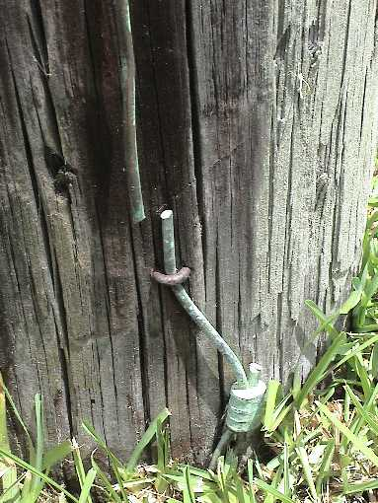
Grounding and Testing Requirements
Inspection
Inspect the lightning protection and grounding systems for buildings and facilities visually and electrically in order to determine their integrity according to Table 1 in AFI 32-1065, Grounding Systems. From a visual inspection, you should be able to determine if:
The system is in good repair.
There are loose connections that might cause high-resistance joints.
Corrosion or vibration has weakened any part of the system.
All down conductors and ground terminals are intact.
All conductors and system components are securely fastened to their mounting surfaces. You may need to relocate some connections to better protect them against accidental
displacement.
There have been additions or alterations to the protected structure which require additional
protection.
There is any visual indication of damage to surge suppression (over voltage) devices.
The system follows the NFPA No. 780 in all areas.

Slide 18
Grounding and Testing Requirements
Maintenance guidelines
The list below is typical areas to look at during self-inspections. The list is only a guide and does not completely cover all areas:
1. Has each facility been inspected to determine the type of protection system installed? Is the system integrally mounted, separately mounted mast, or overhead wire?
2. Is the lightning protection system connected to a ground loop conductor? (A ground loop
conductor is a buried cable surrounding the facility to which the down conductors and
grounding rods are connected.)
3. Are people from the testing agency, Base Civil Engineering (BCE), familiar with lightning
protection systems? Do they know where the test locations are?
4. Do people conducting the testing and inspections know where the points for connecting test leads are?
5. Are all test agency people who could or do perform the tests or inspections familiar with AFI 32-1065?
6. Are static grounding systems installed as separate systems? Are they connected only to
lightning protection system down connector or to a ground loop conductor?

Slide 19
Grounding and Testing Requirements
Maintenance guidelines cont.
7. Are static grounding systems presently connected to ground?
(a) Are contact points free of corrosion, paint, grease, oil, or other agents that weaken or
preclude good bonding?
(b) Are connections made to telephone grounds, electrical conduit systems, or lightning
protection air terminals (lightning rods)? (NOTE: Connection must be made to the
lightning protection system down conductor at ground level.)
8. Are both the user and testing agencies aware of all facilities that have been identified as housing or being used to conduct hazardous operations? Are they familiar with any special test and/or inspection requirements?
9. Are tests being inspected at the required frequency?
10. Are large metal masts being checked for continuity to ground?
1 1. Are tests conducted with the proper test instruments?
12. Are people conducting tests familiar with the location of test points and the relationship
between various components of the system being tested?

Slide 20
Grounding and Testing Requirements
Recordkeeping
Accurate records are important for the continuity of testing between different people and also show changes in readings over a period of time. Below is are suggested record keeping procedures and what the records should show in addition to the date of the inspection or test. Forms you could use for recording are the Air Force general-purpose forms (3000 series) or AFTO Form 481, Station Ground Resistance Record. Such forms are simple to modify for recording tests. For communications facilities, use the forms listed in MIL-HDBK424A, if available. The using agency may require a copy of the completed form. Each facility or area should have records that include a sketch of the grounding system as well as documentation of all inspections and tests. For each inspection or test, describe deficiencies found, corrective action, and the date of repair. The using agency may need a copy of test reports..

Slide 21
Summary
Meters and Test Equipment
Grounding Principles
Grounding and Testing Requirements

