Slide 1
Planning Considerations
Silver Flag

Slide 2
Overview
References
Control zones
Escape routes
Safe locations
Safety officer
Safety
Safety briefing
PPE safety
Incident Action Planning & Responder Role
Entry and back-up team briefings
Radio communication
Hand and verbal emergency signals
Incident Action Plan

Slide 3
References
AFI 10-2501
AFMAN 10-2502
AFMAN 10-2503
AFMAN 10-2507
AFTTP(I) 3-2.44
FEMA ICS-100, 200, 300, 700

Slide 4
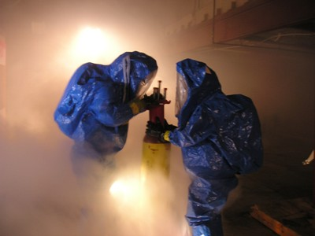
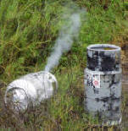
Control Zones
Site control
Defines contours of the zones
Hot zone-exclusion zone where contamination is
Warm zone-Contamination Reduction Corridor (CCR) where decon occurs
Cold zone-uncontaminated area
Incorporate into travel time and possible PPE
Hot zone
Warm Zone
Cold Zone
Containment Control line
Hot line

Slide 5
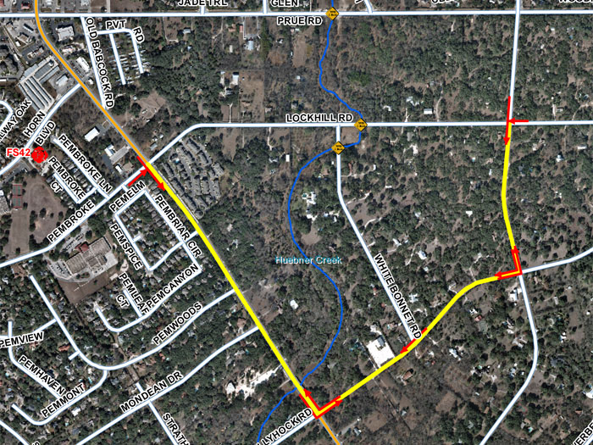
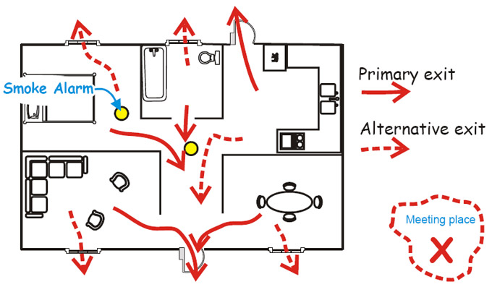
Escape Routes
Identify primary and alternate routes
Located upwind from incident
Used to enter and exit scene
Include facility escape routes
Used when incident degrades and there is an immediate danger to life and health
Helps rescue to find entry team

Slide 6
Safe Locations
Correlates to escape routes
Outside of known hazard area
Make sure personnel are aware of evacuation safe locations
Primary
Alternate

Slide 7
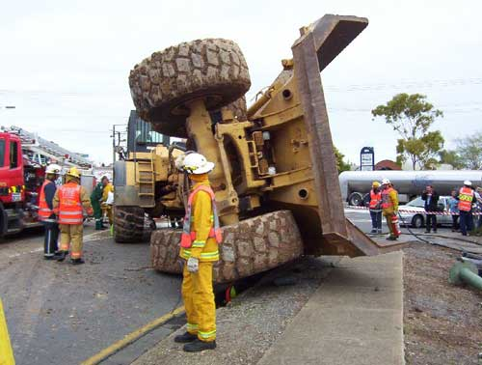
Safety Officer
Roles include
Safe operations
Safety briefing
Major player in entry planning process
Identify possible hazards

Slide 8
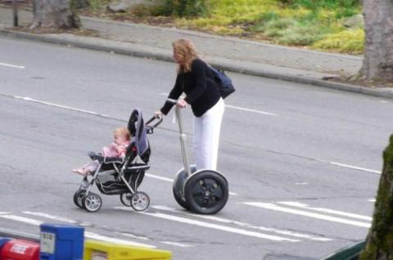
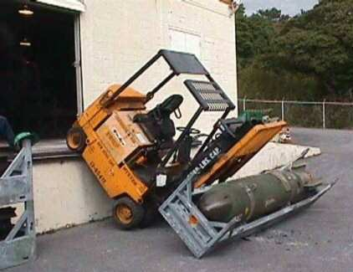
Safety
Everybody's responsibility
In every response, there are safety and health hazards
Always appoint safety officer
Anyone can stop a response at anytime

Slide 9
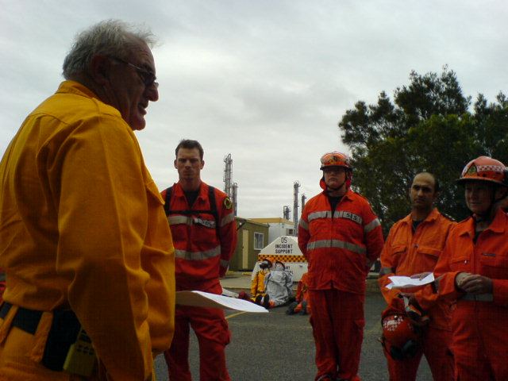
Safety Briefing
No Specific format
Includes but not limited to:
Turn back times
Possible Hazards
Tripping
Confined space
Turn back limits
Ph level
LEL
Radiation limits
Oxygen levels
Each piece of equipment
Escape routes
Safety locations
Hand Signals

Slide 10
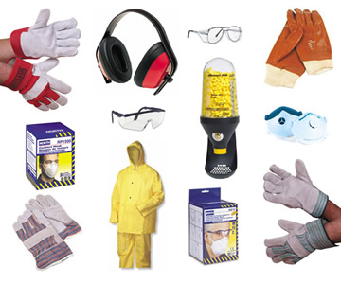
PPE Safety
PPE items need to be addressed before entering scene
Air checks
Buddy system
Turn back criteria
Suit

Slide 11
Incident Action Planning
Objective
Over arching goal
Determined by IC
Can change due to effectiveness, resources, and safety
Strategy
Determined by Operations Chief
General plan to accomplish objective
Cost/time/resources effective
Political/environmental considerations
Can have multiple to accomplish objective

Slide 12
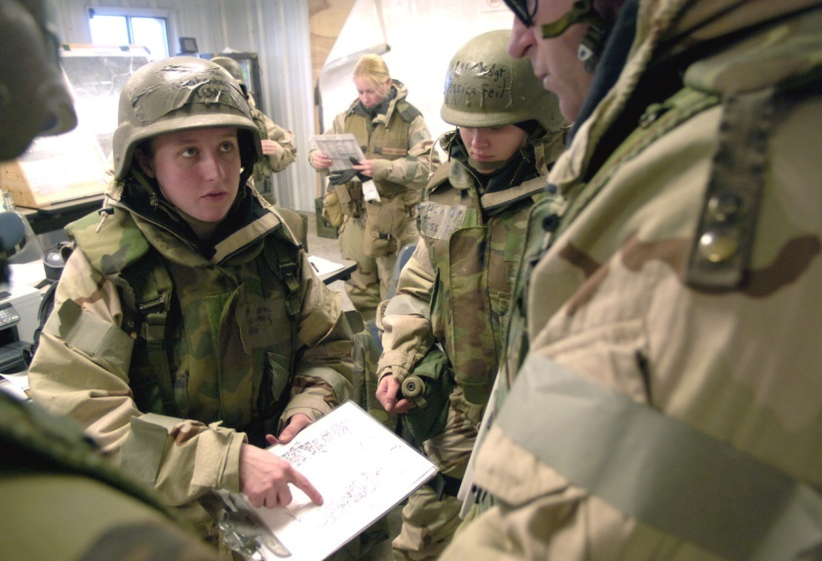
Responder Role
Tactical
Decided by Team Chief
What needs to be done
What resources are needed
Valid/adequate to meet objective and strategy
Usual role of EM responder

Slide 13
Sample Strategy and Tactics
Objective: Receed reservoir level to 35 feet by 0800 on 2/10.
Strategy #1: Reduce/divert inflow.
Strategy #2: Release water from spillways.
Selected Strategy: Pump water from reservoir.
Tactics: Use truck-mounted pumps working from the road into spillway, and portable pumps on the east side discharging into Murkey Creek.
Resources: 5 crews with (3) 1,500-gpm truck-mounted pumps & (2) 500-gpm portable pumps
Notes:
Usual role of EM responder

Slide 14
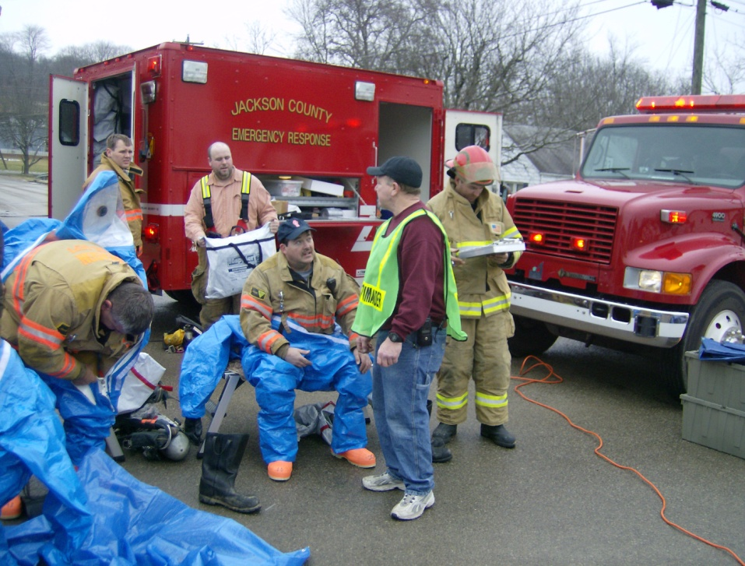
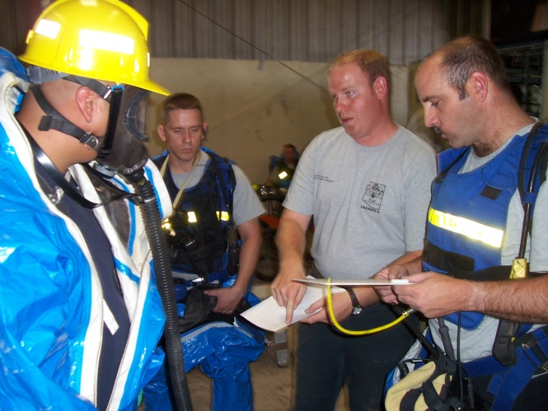
Entry and Back Up Team Briefings
Entry briefings should be accomplished
All teams need to be on the same page for response and emergency procedures
Normally conducted during safety briefing

Slide 15
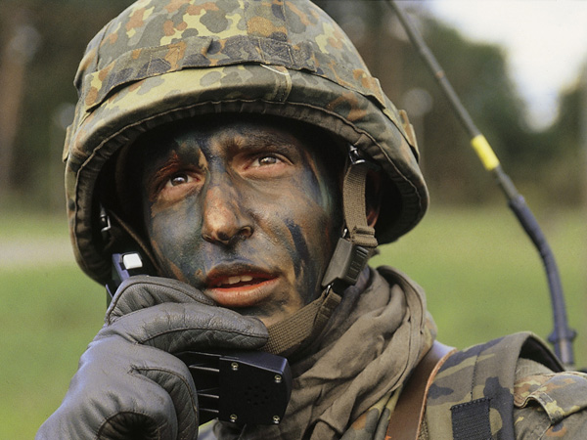
Radio Communication
Include in briefings
Call signs
Radio discipline
Periodic radio checks
Operating channels

Slide 16
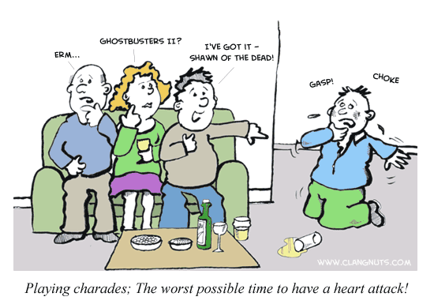
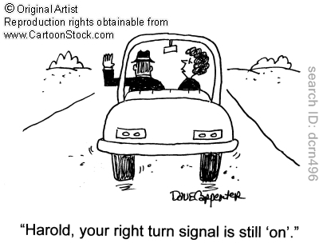
Hand/Verbal Emergency Signals
Talking to each other doesn’t always work
Use radios to communicate
Identify hand signals to communicate
Ensure all teams understand hand signals
Withdrawal signal
Verbal, hand, or other
Used when the need for an emergency evacuation arises

Slide 17
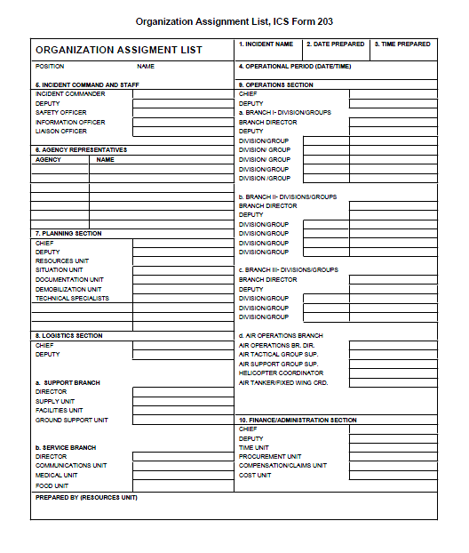
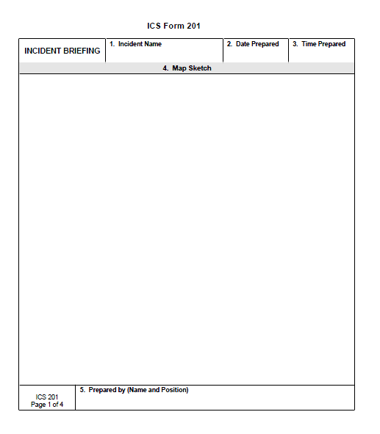
Incident Action Plan
Composed of standard forms and supporting documents
IAP cover sheet
ICS 202, Incident objectives
ICS 203, Organization assignment list
ICS 205, Incident communications plan
ICS 206, Incident medical plan
Safety messages, maps, forecasts

Slide 18
Are All Forms Used?
Incident Commander determines which ICS forms and attachments are included in IAP.
For less complex incidents, Incident Commander may only require:
Incident Objectives (ICS 202)
Organization Assignment List (ICS 203)
Division Assignment List (ICS 204)
A Safety Message, and a map of incident area.
ICS 202
ICS 203
Incident Objectives
Organization Assignment List
ICS 204
Safety Messages
& Map
Division/Group Assignment List

Slide 19
ICS Form 202

Slide 20
ICS Form 202

Slide 21
ICS Form 203

Slide 22
ICS Form 204

Slide 23
ICS Form 204

Slide 24
ICS Form 204

Slide 25
ICS Form 204

Slide 26
ICS Form 205

Slide 27
ICS Form 206

Slide 28
Summary
References
Control zones
Escape routes
Safe locations
Safety officer
Safety
Safety briefing
PPE safety
Incident Action Planning & Responder Role
Entry and back-up team briefings
Radio communication
Hand and verbal emergency signals
Incident Action Plan

