Slide 1
Decontamination
Silver Flag

Slide 2
Overview
References
Definition
Responsibilities
Planning Factors
Site Layout
Methods
Contamination Control
Determining Effectiveness
Decontamination Processes

Slide 3
References
AFI 10-2501
AFMAN 10-2503
AFMAN 10-2504
AFMAN 10-2507
AFTTP 3-2.60
DoD 3150.8-M, NARP

Slide 4
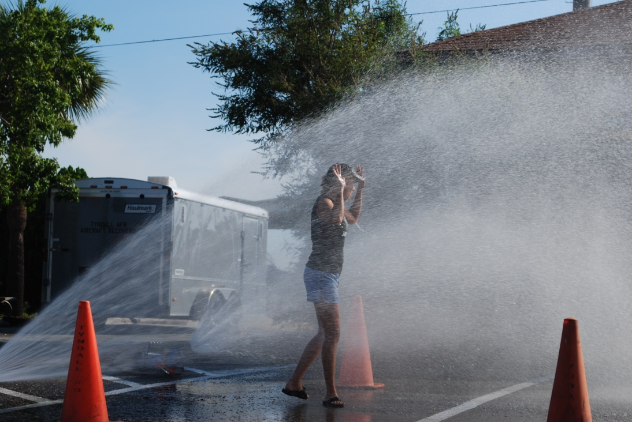
Definition – Emergency Decon
Physical process of immediately reducing contamination of individuals in potentially life-threatening situations with or without formal establishment of decon corridor
EPA does not require runoff control when a process is used to save lives or reduce injury
Notes:
AFMAN 10-2503

Slide 5
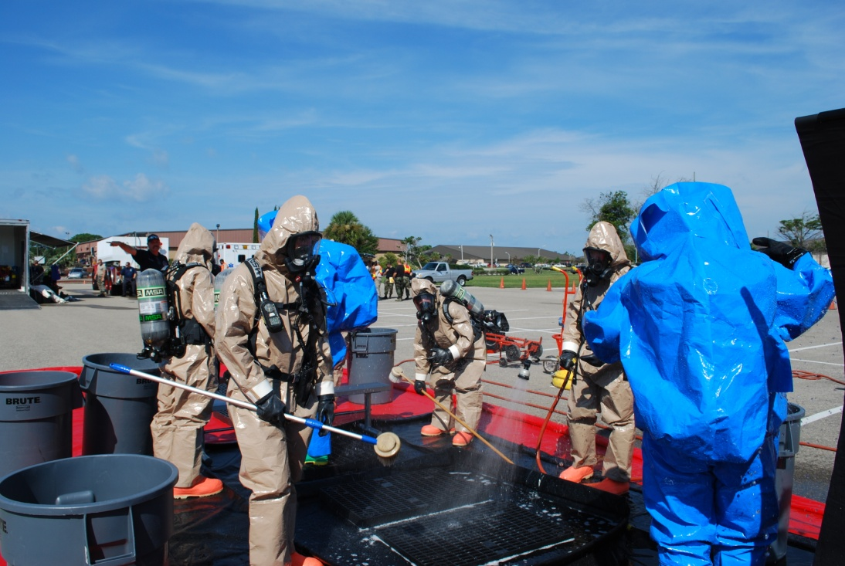
Definition – Technical Decon
Physical or chemical process of deliberate decon to achieve a thorough cleansing and removal of contaminants from personnel and equipment
  EPA requires runoff control
Notes:
NOTE: Terms for traditional CBRN decon are Immediate, operational, thorough, and clearance

Slide 6
Responsibilities
Installation Subject Matter Areas of Expertise
MAJOR AREA | SUB AREA(S) | OPR/OCR
Decontamination | General techniques and procedures | EM
 | Personnel decontamination | EM, Fire Emergency Services
 | Patient decontamination | Medical
 | Facilities and area | Civil Engineer
 | Vehicle | Logistics Readiness Squadron
 | Aircraft and munitions | Maintenance
Notes:
AFMAN 10-2503 Table A6.15. Installation Subject Matter Areas of Expertise

Slide 7
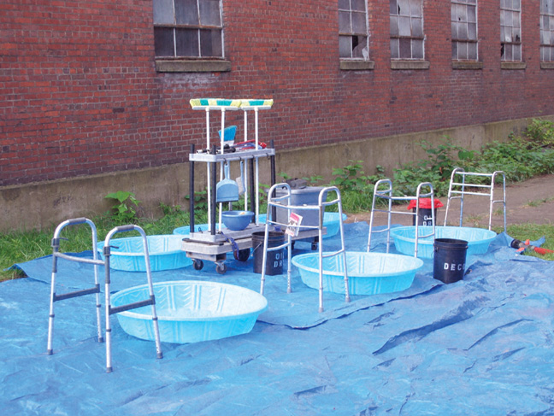
Planning Factors
Before initiating decon consider:
  Area free of contamination
  Safety
  Available resources (immediate/adequate)
  Current weather factors
  Site drainage
  Terrain
  Surface type
  Available water source

Slide 8
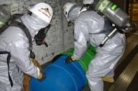
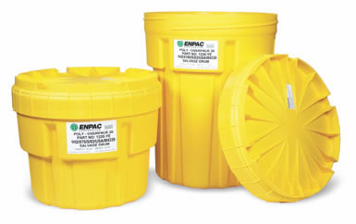
Planning Factors
Disposal Methods – on-site
  Ensure waste is in:
    Non-leaking containers with lids
    Tight fitting
    Not cracked, broken or chemically damaged
    Compatible with waste contained
    Visibly identified as HazMat
    Approved markings
    Contents identified

Slide 9
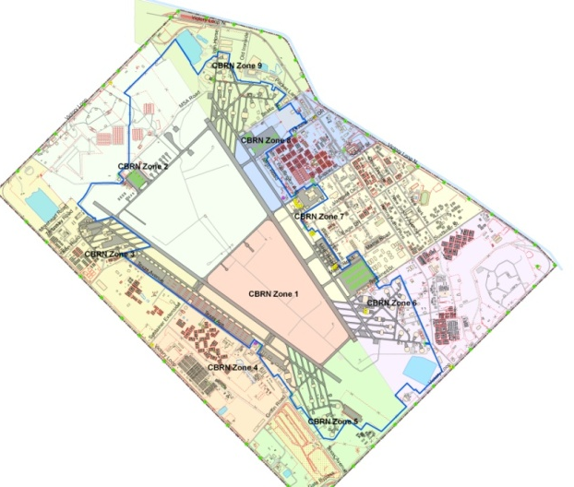
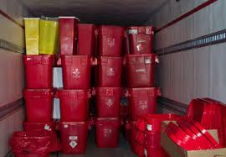
Planning Factors
Disposal Methods – temporary/long-term storage
  During planning address/prepare for identification, marking, handling/disposal of contaminated waste
Notes:
AFMAN 10-2503 Paragraphs 2.2.14.3.5. and 2.2.14.4.2.

Slide 10

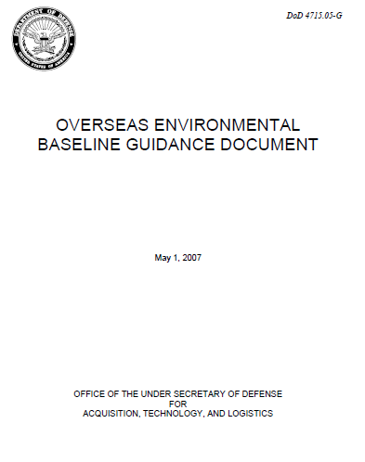
Planning Factors
Disposal Methods – final disposition
  CONUS
    EPA
    State and Local governments
  OCONUS
    Overseas Environmental Baseline Guidance Document (OEBGD)
    Country Final Governing Standard (FGS)

Slide 11
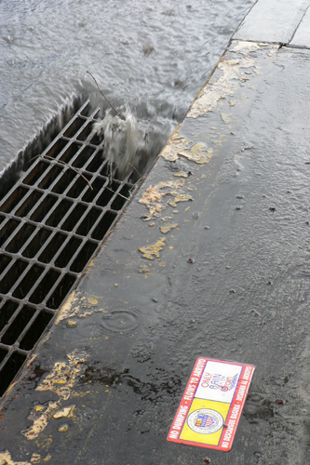
Planning Factors
Run-off Control
  Viable/necessary technique during irregular warfare situations
  Adequate berm should be erected surrounding any area where contaminated run-off or waste is anticipated
Notes:
AFMAN 10-2503 – Paragraph 2.2.14.3.2.

Slide 12
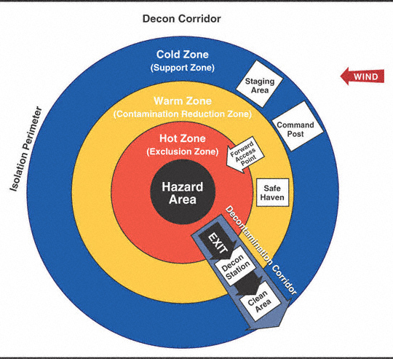
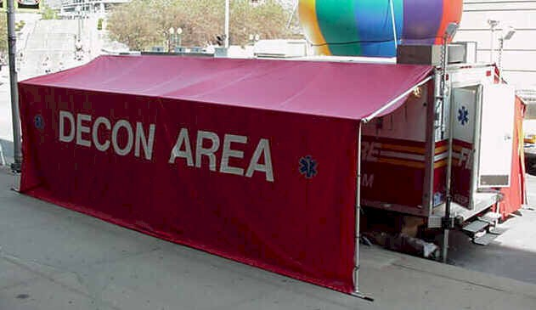
Site Layout
Decon corridor is a vital part of any incident and requires specific equipment to operate

Slide 13
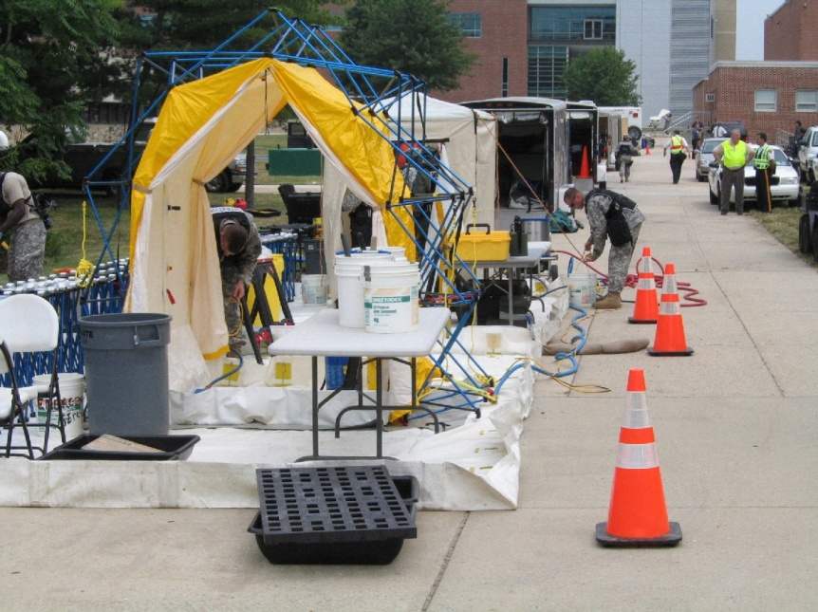
Site Layout
Inside warm zone and upwind of hot zone
Establish entry point
  Traffic cones on warm/hot zone edge
Establish exit point
  Traffic cones on warm/cold zone edge
  Contamination Control Line (CCL) – unprotected personnel can not cross

Slide 14
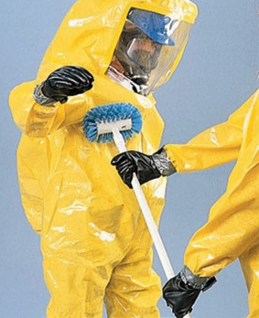
Methods - Physical
Physical removal of contaminant from person or object
Reduces contaminants concentration
Generally contaminant remains chemically unchanged
Examples
  Absorption
  Brushing and scraping
  Isolation and disposal
  Vacuuming
  Washing

Slide 15
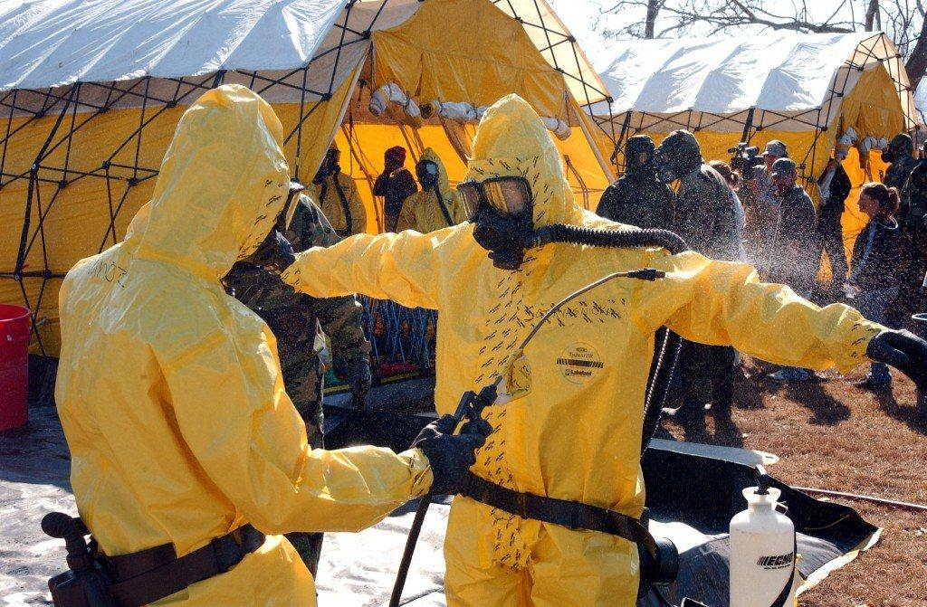
Methods - Chemical
Generally changes contaminant through some type of chemical reaction
Case of etiologic contaminants, chemical methods are actually biologically “killing” organisms
Examples
  Adsorption
  Chemical degradation
  Disinfection or sterilization
  Neutralization
  Solidification

Slide 16
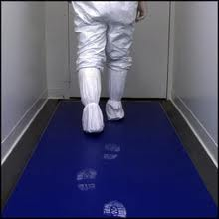
Contamination Control
Effectiveness is directly related to degree of effort put forth regarding this area in planning phase
If contact with contaminant can be controlled
  Risk of exposure is reduced
  Need for decon can be minimized
Cross contamination can occur if CBRN materials remain on surface
  Material where CBRN is rapidly absorbed, leaves a vapor hazard not a contact-transfer hazard
Notes:
AFMAN 10-2503 Paragraph 2.2.14.3. and 2.2.14.3.1

Slide 17
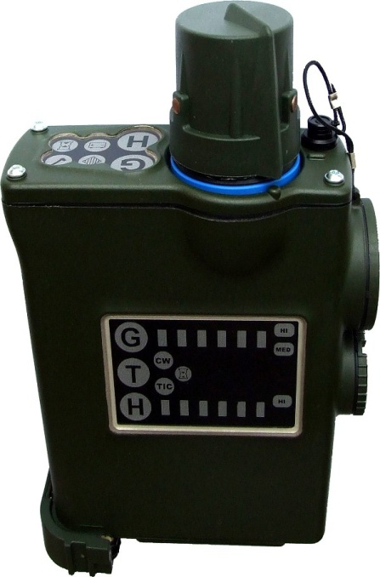
Determining Effectiveness
Reduce to ALARA
Effectiveness should be assessed throughout
  Change method of decon, if necessary
Method to effectively assess decon
  Visual observation
    Stains, discolorations, and corrosive effects
  Monitoring devices
    PIDs, detector tubes, monitors, and Ph paper
    Understand detector threshold limitations
  Wipe sampling

Slide 18
Decon Process
Station 1: Individual Gear Decon
Station 2: Overboot/Hood Decon
Station 3: Overgarment Removal
Station 4: Overboot/Glove Removal
Station 5: Monitoring
Station 6: Mask Removal
Station 7: Mask Decon
Station 8: Reissue Point
Notes:
It is important to remind students that there is a difference between decon processes (i.e. Contamination Control Area, Contamination Control Station) and Decon Systems (i.e. CAPS, CBRIPS, Hit and Run Kits, etc).

Slide 19
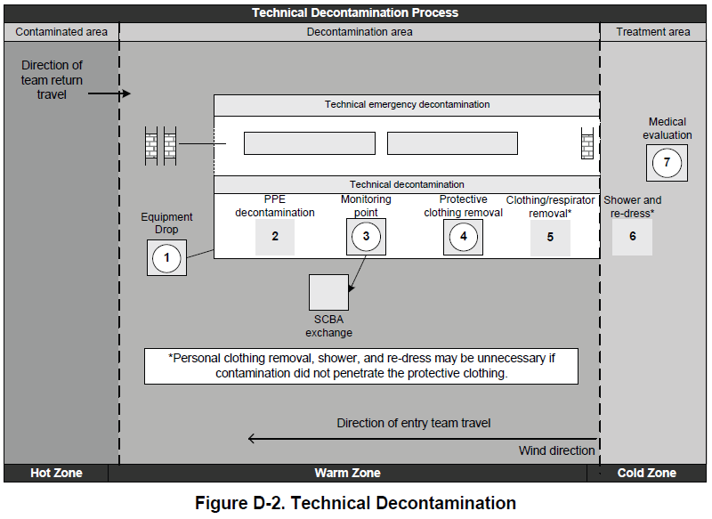
Decon Process: Technical

Slide 20
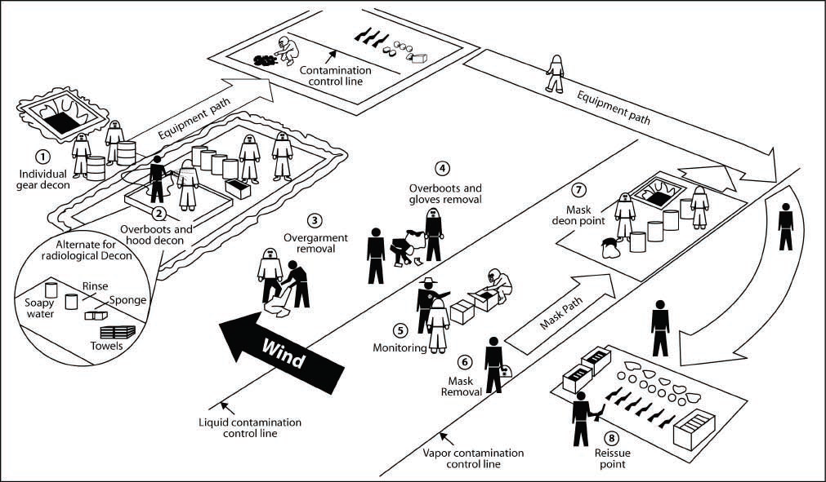
Decon Process: CCA

Slide 21
Decon Process:CCA
Planning & preparation:
  Fixed vs Mobile
  Can be co-located with Aircrew
  Mask-refurbishment Location/Procedures
  Weapons Decon and Storage Location/Procedures
  Trash Disposal
  Coordination with agencies for water, supplies, equipment stocking and re-supply
  Staffing:
    CCA Supervisors
    CCA Attendants
Notes:
This information is taken from AFMAN 10-2503. Attachment 9 has detailed procedures for CCA Manning and as well as the process.

Slide 22
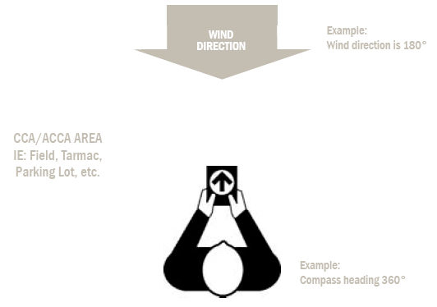
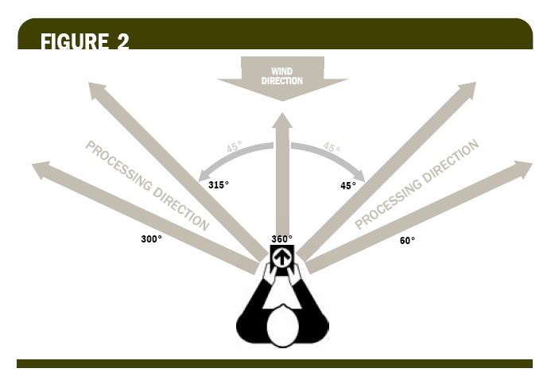
Decon Process: CCA
CCA Establishment
Notes:
When establishing a CCA, the first step is to ensure proper site selection while considering weather, terrain, amount of space needed, accessibility, etc. Before laying out the color-coded rope, stand into the wind with a compass heading of 360 degrees. Then, choose a 45 degree angle to the left or to the right at which to lay the rope, heading crosswind.

Slide 23
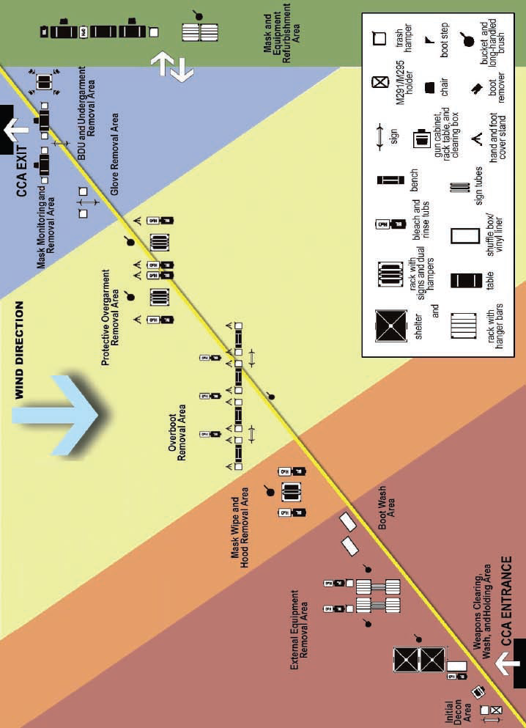
Decon Process: CCA
Contamination Control Area

Slide 24
Decon Process: CCS
Orderly processing of personnel, equipment, and vehicles entering and leaving the contaminated area
Planning Considerations:
  Site Selection
    Upwind or far enough away to prevent contaminants from entering
    Run-off Control
  Sampler Placement
  Contaminated Waste Disposal
  Staffing
    CCS Supervisor
    Monitors
    Assistants
Notes:
The NARP provides manning information for CCS operations as well as a recommended materials listing. The NARP should be used for all set-up and processing procedures.

Slide 25
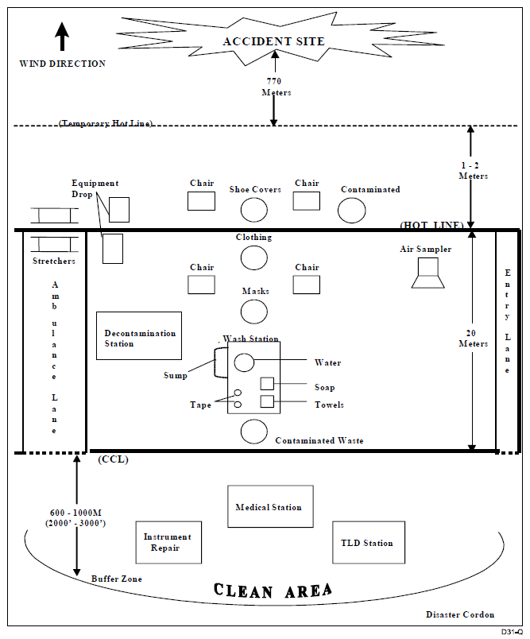
Decon Process: CCS

Slide 26
Summary
References
Definition
Responsibilities
Planning Factors
Site Layout
Methods
Contamination Control
Determining Effectiveness
Decontamination Processes

