Slide 1

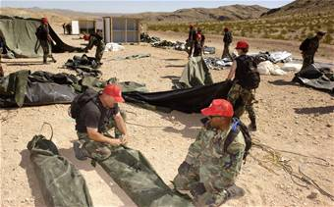
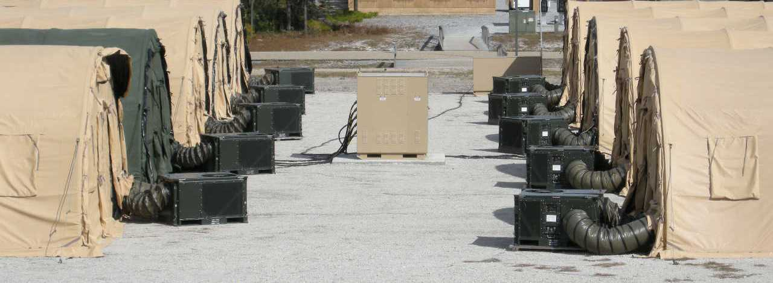
HVAC Bed Down Planning

Slide 2
Overview
Uses
Pros/Cons
Specifications
Components
Variations
Installation
Maintenance
Troubleshooting
Charging and Recovery Methods

Slide 3
Overview
UTCs
Basic Tent Layout
HVAC Bed Down
Power Supply
ECU Layout
Tent Block Capacities
Load Calculations

Slide 4
Unit Type Codes (UTC)

Slide 5
BEAR Order of Battle UTCs
What's a UTC? (Unit Type Code)
  A group of assets or a kit designed for quick and easy deployment planning
BEAR UTC vs BOB UTC
  BEAR
    had 42 UTCs but were very large and often provided more than needed
    BEAR has been the norm since 2001
  BOB (BEAR Order of Battle)
    Has 2,025 smaller UTCs allows a force to tailor the assets to the requirement better
    Switch started in 2007
    Smaller footprint on ground (only take what you need)

Slide 6
Reading a UTC
5 Character Code
4
F
P
E
T
26 PAX Prime BEEF Team
Detail of Kit
A- Air Transport Cargo
S- Surface Transport Cargo
P- Personnel
9- Tools and Equipment
Defines Type of Kit (personnel, equipment, etc.)
4F-Civil Engineer Personnel
XF-Civil Engineer Equipment

Slide 7
Current HVAC Equipment UTCs
FDECU- XF#AC (#: A for Air or S for Surface)
  12 ea
    Air config-on 463L Pallet
    Surface config-all items in TRICON shipping container
130K Heaters- XF#CW
  12 ea
    Air config-on 463L Pallet, ducts/stacks strapped to top
    Surface config-all items in TRICON shipping container
ADR 300- XF#CH
  1 ea
    Same config for air and surface
    TRICON Refrigerator will be used for surface transport once fully developed

Slide 8
Civil Eng. HVAC Personnel UTCs
4FPAR- 3 PAX HVAC & Control Team
  2 Journeyman and 1 Apprentice HVAC
4FPET- 26 PAX Prime BEEF Eng. Team
  1 Officer, 25 Enlisted
  3 HVAC-1 Craftsman, 1 Journeyman and 1 Apprentice
All larger requirements are built off of these smaller modules to create a custom package for deployment

Slide 9
Bare Base Layout

Slide 10
Basic Tent Layout
8 to 12 tents in a tent block
  Tent block size is based off of load requirements
    ECUs are the largest consumer of power in a tent city
Tent Block Layout
  Utility lane (rear of tent)
    30ft. from tent to tent
  Fire lane (front of tent)
    59ft. from tent to tent
  Tent Spacing
    12ft. distance between tents for guy ropes
Only BCE or Fire Marshall can change spacing

Slide 11
Tent Block ECU Layout
FDECU layout shown (10 tents per block)
HIGH VOLTAGE
TENT
ECU
TENT
ECU
TENT
ECU
TENT
ECU
TENT
ECU
TENT
SDC
ECU
TENT
ECU
TENT
ECU
TENT
ECU
OPTIONAL BACKUP GENERATOR
TENT
ECU

Slide 12
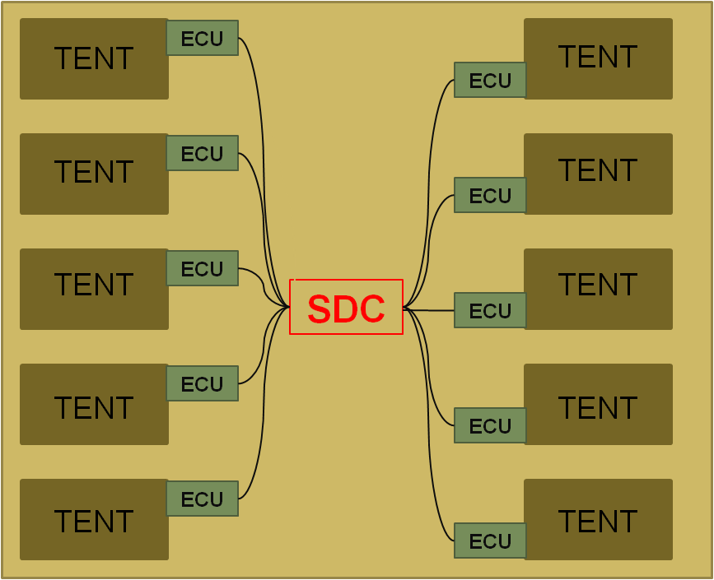




HVAC Bed Down
640 PERSON MAX CAPACITY CAMP
SHOWER SHAVE UNIT
WATER HEATERS
EMERG. BACKUP GENERATOR
DINING AREA
REFRIGERATION UNITS
KITCHEN
MOURGE
GENERATOR
ADR 300
FROM POWER PLANT (HIGH VOLTAGE 4160 VAC)
PHYSICALLY SEPERATED FROM CAMP

Slide 13
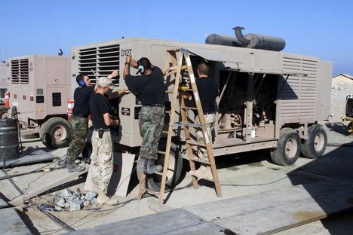
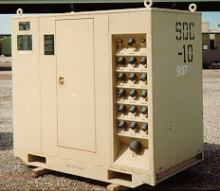
Power Supplied By
MEP 12 or IBEAR (New)
MEP 12 Generator
  Diesel driven (55 Gals per hr)
  Trailer Mounted
  750 KW output
Secondary Distribution Center (SDC)
  Skid mounted
  150 KW total output
  16 ea 60 amp outputs
  Input-4160 VAC, 60 Hz, 3 Ph
  Output-120/208 VAC, 60 Hz, 3 Ph
  Secondary input for 120/208 VAC generator
Depending on location power may also be supplied by various other types of generators and/or commercial power

Slide 14
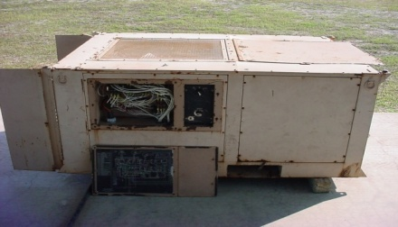
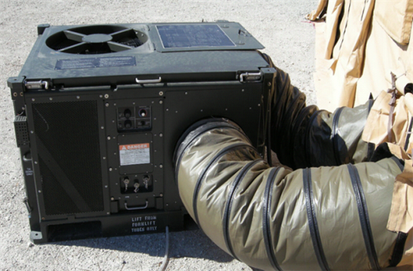
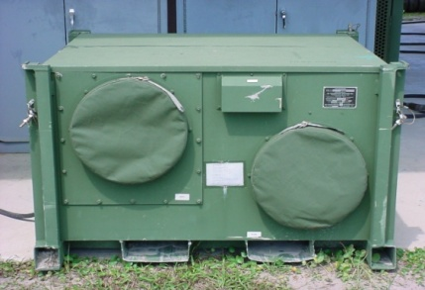
Tent Block Capacities
Due to power requirements the type of air conditioners used in a tent city determines how many tents are placed in a tent block
-39 ECU
  12 Per tent Block
FDECU -2 to -9
  Under 125 ºF: 10 Per tent block
  Over 125 ºF: 8 Per tent block
HAC -36
  12 Per tent block
Commercial Units
  Often have a lower power draw than ECUs

Slide 15
Determining Load
Power distribution system is rated in KW
Three Ph KW=(A x V x 1.73) / 1000
Example: -39 ECU draws 29 amps
  (29 x 208 x 1.73) / 1000 = 10.43 KW
Example: FDECU -2 to -9 draws 41.5 amps
  (41.5 x 208 x 1.73) / 1000 = 14.93 KW

Slide 16
Bed Down Layout
SHOWER SHAVE UNIT
640 PERSON MAX CAPACITY CAMP
WATER HEATERS
EMERG. BACKUP GENNERATOR
DINING AREA
REFRIGERATION UNITS
KITCHEN
MOURGE
GENNERATOR
ADR 300
FROM POWER PLANT (HIGH VOLTAGE 4160 VAC)
PHYSICALLY SEPERATED FROM CAMP

Slide 17
Questions
?

